Slide 1
Surgery of small intestine
Presented by
Dr. Mokhtar Bahbah
Ass. Professor of general surgery
Benha Faculty Of Medicine

Slide 2
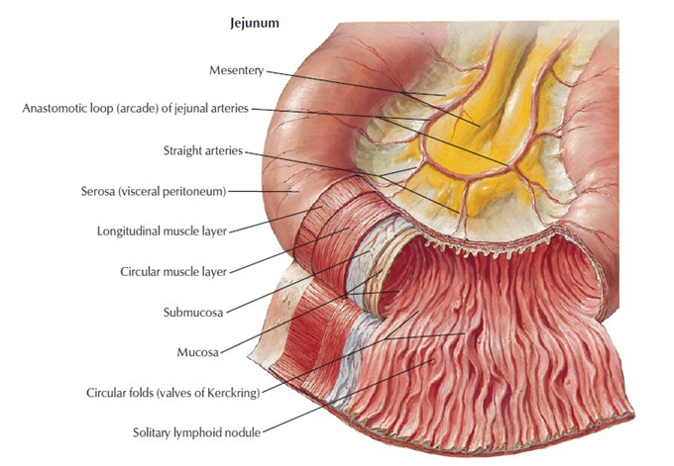
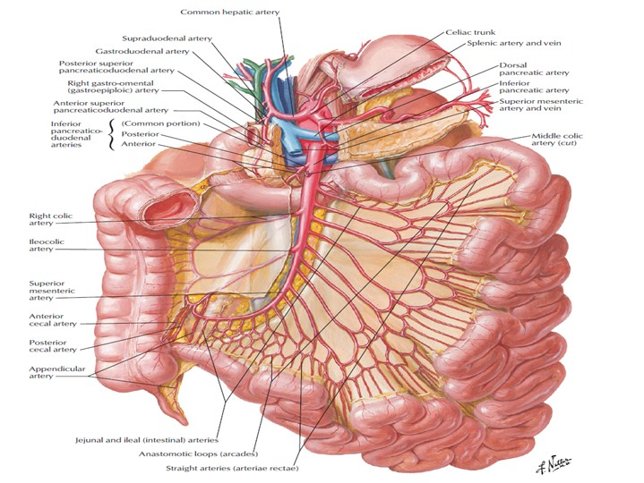
Surgical anatomy

Slide 3
Functions of small intestine
Absorption (main function)
Secretory function
Digestive function

Slide 4
Intestinal Obstruction
Classifications:
Mechanical (dynamic) or ileus (adynamic)
Acute or Chronic
Small or Large intestine

Slide 5
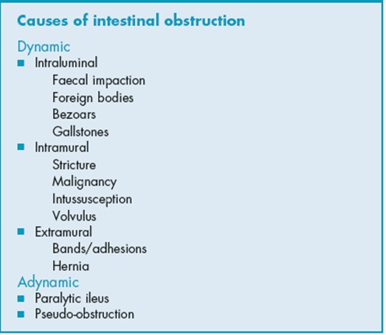

Slide 6
Pathology of intestinal obstruction:
Simple obstruction:
Collapsed loop distal to the obstruction
distension with hyperperistalsis proximal to the obstruction
with time there is impairment of the blood supply followed by ulceration and perforation
Strangulation obstruction:
In addition to the above the bacteria and toxins in the lumen pass
to the peritoneal cavity causing septicaemic shock

Slide 7
Clinical features
Colicky central abdominal pain
Vomiting
Abdominal distension
Constipation

Slide 8
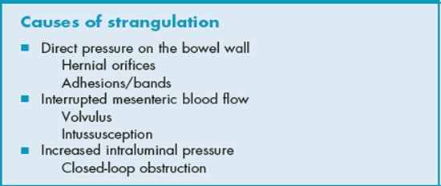

Slide 9
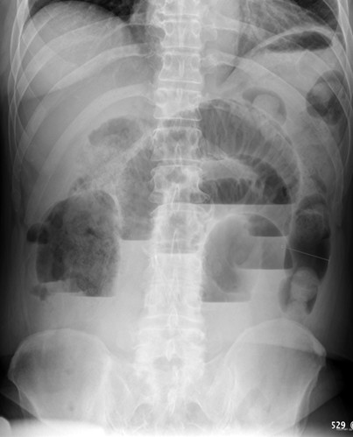
Investigations:
Complete blood count
Blood chemistry
Abdominal x-ray (erect & supine)
C-T abdomen with oral and i.v contrast
Investigations for G.A. fitness if surgery is planned

Slide 10
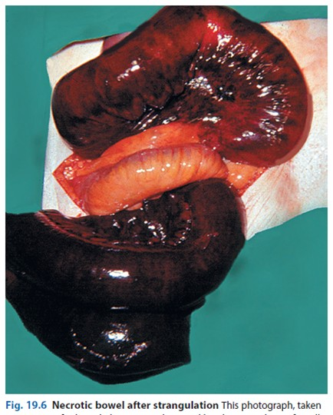

Slide 11
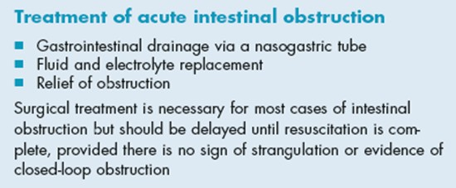

Slide 12
Paralytic ileus (adynamic obstruction)
This may be defined as a state in which there is failure of transmission of peristaltic waves secondary to neuromuscular failure
The resultant stasis leads to accumulation of fluids and gas within the bowel with associated distension , vomiting , absence of bowel sounds and constipation
Causes: postoperative , metabolic abnormalities , peritonitis , drugs

Slide 13
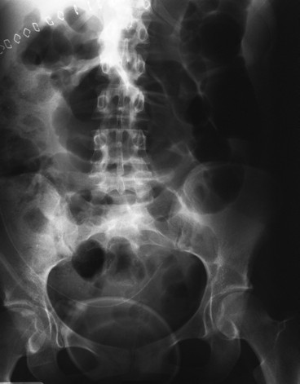
Investigations of paralytic ileus:
Plain x-ray of the abdomen
Blood urea and electrolytes

Slide 14
Treatment of paralytic ileus:
Prevention and correction of biochemical disturbances especially hypokalaemia , gentle handling of the intestine and nasogastric tube in major abdominal surgery to decompress the bowel
Treatment of established cases by intravenous fluids , nasogastric tube , correction of metabolic abnormalities
Resistant cases can be treated by parasympathomimetics as prostigmine

Slide 15
Chronic intestinal ischaemia
Caused by narrowing of the superior mesenteric artery and affects elderly patients
Aetiology: main cause is atherosclerosis but other rare causes as median arcuate lig. Compression, neurofibromatosis, radiation or thromangitis obliterans
C/P.: Postprandial abdominal pain and loss of weight
Investigations: exclude other causes of abd. Pain by U/S. and endoscope
Aortography
Treatment: Endarterectomy or Bypass dacron graft
- Division of median arcuate ligament

Slide 16
Acute intestinal ischaemia
Very serious surgical emergency
May be focal (affects small segment) or large segment
Aetiology:
1. acute occlusion:
- Mesenteric art. Embolism
- Mesenteric art. Thrombosis
- Mesenteric venous thrombosis
2. Non-occlusive ischaemia:
low cardiac output as arrhythmia and major sepsis

Slide 17
Acute intestinal ischaemia
Pathology:
- Ischaemic damage. Within hours
- Reperfusion damage. Return of the blood supply either spontaneously or surgical leading to damage of the cell membrane
Clinical picture:
- acute abd. Pain
- vomiting
- bleeding per-rectum
- peritonitis

Slide 18
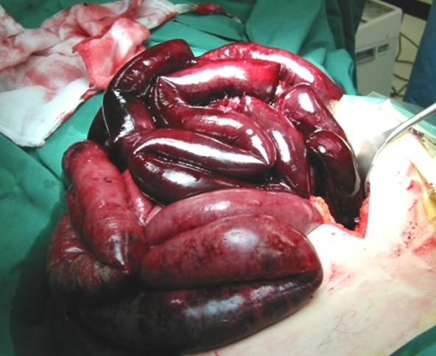

Slide 19
Management of acute intestinal ischaemia:
No specific or sensitive test to prove the diagnosis.
Blood picture: markerd leucocytosis
Increases serum levels of amylase and lactate
X-ray abdomen shows air fluid levels
Selective angiography or digital subtraction angiography (not available in most centers)
treatment: Urgent surgery
up to 70% of the small intestine can be resected

Slide 20
Crohn's disease (Regional ileitis)
A disease of uncertain aetiology.
Characterised by full thickness inflammatory process of any part of GIT from lips to anal margin.
Pathological features include full thickness inflammation, edema, fissures/ulceration, non-caseating foci of epithelioid and giant cells
Thickened mesentry with enlarged lymph nodes
There are skip areas of healthy bowel between the diseased loops

Slide 21
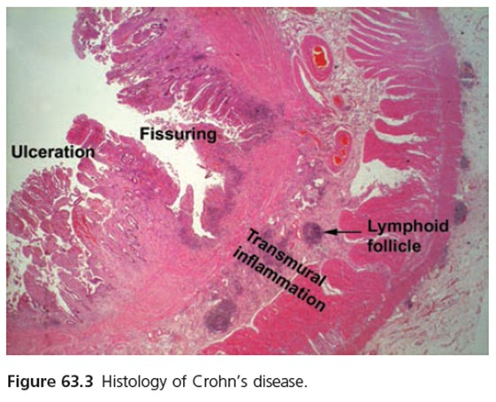

Slide 22
Clinical features of crohns disease:
Acute
Pain in the right iliac fossa with tenderness mimicks acute appendicitis.
Features of low small bowel obstruction
Rarely perforation causing peritonitis
Chronic
Colicky abdominal pain with diarrhea
Weight loss
Perianal fistula
Fistulation into adjacent organs like bladder, colon, vagina

Slide 23
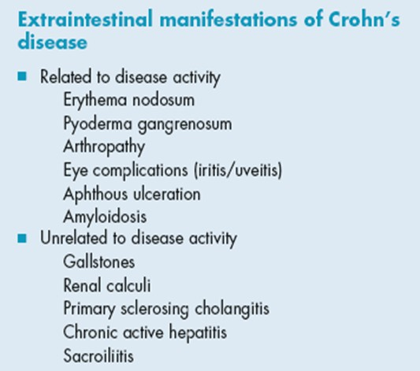

Slide 24
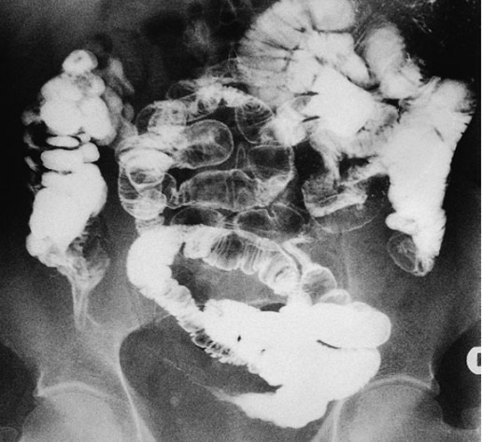
Investigations:
Barium meal and follow through (string sign of kantor).
Colonoscopy and Biopsy
Biopsy of suspected anal fissure and fistula

Slide 25
Treatment:
Corticosteroids.
Low residue, high protein and calorie diet with vitamins and minerals
Aminosalicylates
Immunomodulators e.g. azathioprine.
Monoclonal antibodies
Antibodies for perianal diseases
Surgery for complications:
limited resections, Strictureplasty or colectomies

Slide 26
Other inflammatory conditions of small intestine
Tuberculosis: (ulcerative type or Hyperplastic type)
Typhoid ulceration and perforation

Slide 27
Meckel's diverticulum
Aetiology: persistent patency of the proximal part of vitellointestinal duct
Pathology: - True diverticulum on the anti-mesenteric border
- Has separate blood supply
- May contain ectopic gastric, pancreatic and colonic cells
- Rule of 2 (2% of population, 2 feet from the caecum, 2 inches in length and symptomatic in 2%)

Slide 28
Meckel's diverticulum
Complications:
- Acute diverticulitis
- Intestinal obstruction
- Incarceration in hernia
- Bleeding
Treatment: surgery ( either excision or resection anastomosis)
- if symptomatic
- if accidentally discovered with narrow neck or young patient

Slide 29
Intestinal Stomas
Ileostomy: either permanent as in procto-colectomy
or temporary as diverting stoma
Can be Continent ileostomy(by fashioning a valve)
or Conventional ileostomy( incontinent)
Jejunostomy: for feeding

Slide 30
Intestinal fistula
Aetiology: - After abdominal operations
- Congenital.
- Abdominal trauma.
- Inflammatory( diverticulitis, Crohn's disease, Radiation).
- Malignant tumours.
Classifications: - Internal or External
- Low output or High output
Complications: Dehydration, malnutrition, electrolyte disturbances, sepsis, skin irritation and maceration
Management: Resuscitation, nutritional support and somatostatin
Surgery indicated if high output fistula or distal obstruction or no improvement for more than 4 weeks

Slide 31
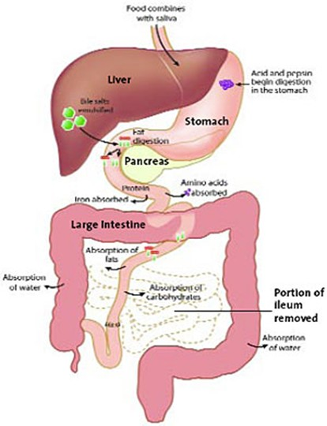
Short gut syndrome
Also called intestinal failure and defined as insufficient intestinal absorptive capacity results in clinical manifestations of diarrhea, dehydration and malnutrition.
Causes:
- Crohn's disease.
- Mesenteric ischaemia.
- Midgut volvulus
- Multiple fistulae.
- Small bowel tumours.

Slide 32
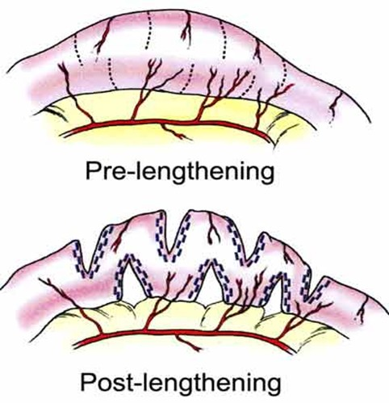
Treatment
Nutritional support including TPN.
Gut lengthening procedures.
Intestinal transplantation

Slide 33
Thank You

